Slide 1
The Sales Affiliate Manual
Last Updated 01.01.22

Slide 2
TIEAKIA SIMONE CASTRO
ROCKIE SAPP
Tieakia Castro, Founder of TRES was born and raised in Paterson, NJ. A hardcore STEM girl, she fell in love with statement pieces, thus birthing her love for fashion. She began TRES as a hobby in August 2010. That hobby quickly blossomed into a full-scale online business. Since the inception of TRES, Tieakia has hired Sales Representatives across the country using fashion to empower women to take control of their financial lives and look good while doing it.. TRES was created to bring classic and trendy looks at an affordable rate to the everyday women looking to slay her day. Tieakia’s overall goal with TRES is to assist women in becoming their own boss through direct selling, while providing a seamless online shopping experience with a wide range of unique fashion and beauty products.
Tieakia holds a BS in Political Science & Accounting from Penn State University, along with a Masters in Accounting specializing in Audit. She has a lovely family, a husband, Jeffrey, and three beautiful children; Jayden, Jayla and Jayana, as well as a Silky Terrier; Lexi. She is an avid sports fan, and currently resides in Georgia.
Rockie Sapp grew up as a military man’s daughter. Because of this there was a lot of moving around in the early years of her life. Rockie attended UGA for both Marketing and Broadcast Journalism. She considers herself more of an “artsy” individual. Prior to joining as the Co-Owner/CEO of Glam Her she expressed herself as a Photographer, Muralist, Actress/Model and Anchor. Having appeared in television shows and hosting a handful of lifestyle based and entertainment news programs. She has a passionate love for makeup (both beauty and FX) and feels it is an art form and way of expression. She truly looks forward to spreading her wings and reaching new and exciting levels with Glam Her and the Glam Her representatives. In addition to running Glam Her she deeply enjoys spending time with her amazing Husband, beautiful children and what she feels is the world's best dog.

Slide 3
Active Vs. Inactive Status
Active Status
All Affiliates are required to have $100 in sales monthly and a combined sales of $100 x the number of months as a Sales Affiliate. For example, if an affiliate has been an affiliate for 3 months, they should have a combined $300 in sales to be recognized as an Active Affiliate. There is a Sales Affiliate incentive that can decrease sales requirement by up to $50 (see later slide).
Inactive Status
Any Affiliate that does not meet their month-to-month requirement of sales (that requirement is $100 monthly and $100 x the number of months an affiliate).
Any Affiliate that is In-Active can only be In-Active for 3 consecutive months. After that period, their membership will be de-activated. You will only be able to join again once you have been de-activated for more than 90 days.

Slide 4
TRES Affiliate Levels of Membership
TRES Rookie | TRES All Star | TRES Super Star | TRES Elite | TRES Legend
Enrollment process completed | 6 consecutive active months at previous level | 6 consecutive active months at previous level | By invitation only | By invitation only
11111 1115% Commission 13456788 | 18% Commission | 20% Commission | 25% Commission | 25% Commission
Wholesale Incentive | Wholesale Incentive | Wholesale Incentive | Wholesale Incentive | Wholesale Incentive
3% Recruitment Rewards | 4% Recruitment Rewards | 5% Recruitment Rewards | 6% Recruitment Rewards | 7% Recruitment Rewards
 |  |  | Meet & Greet expenses will be reimbursed via Gift Card | Quarterly Bonus Received via Gift Card
* Commission rates/incentives are at the sole discretion of the CEO’s and can change at any time
* Membership Levels are adjusted quarterly
* Recruitment Rewards are in the form of a Gift Card and paid out quarterly

Slide 5
Commission
Commission is earned on all regular Website Sales (excludes Wholesale and other Affiliate Incentive Orders)
Commission Rate (15-30%) depends on your Level of Membership (see Chart on previous page)
Commission is paid out on the 28th of each month for previous months sales (if it falls on a weekend/holiday it will be paid on the next Business Day)
Commission will be paid via Paychex (there is a $4 transaction fee charged by Paychex for Direct Deposits)
If you are an In-Active Affiliate your commission will be accrued and paid out once you are in Active Status again.
If your total commission payout is less than $20 your commission will be accrued and paid out during the next commission payout if $20 or greater.
Any issue or question regarding commission payouts should be sent in detail to Rep Services at repservice@iamtres.com

Slide 6
How to Order?????
6
Customer Orders can only be placed via our website. Our website address is www.iamTRES.com
During checkout, your customer should select your name as their Sales Affiliate for you to receive credit of their order. If at anytime your customer forgets to select your name, the customer can email customerservice@iamtres.com with their order number and affiliate name
To check orders placed by your customers you will need to sign into your Affiliate Area. You should be able to see all your customers that placed an order as well as the commission earned for all orders. If you notice an order is missing, please email repservice@iamtres.com

Slide 7
Payments Accepted
Any website orders $35 or more can be paid with Afterpay, Klarna, Sezzle or Zip. Divide your total order into 4 equal interest-free payments.
All Major Credit/Debit Cards are accepted.
All orders can be paid via PayPal. Customer would just select PayPal Checkout.

Slide 8
TRES Shipping Policy
TRES has a fulfillment center located in GA that ships all orders. Orders are shipping within One Business Day from the date of purchase for all orders placed before 2pm EST, if after 2pm EST please allow 2 Business Days (and within 3 Business Days during Major Holidays and our Anniversary Month - August).
We observe all Federal Holidays as our carriers does not ship on these days.
We ship with various carriers (including USPS, FED EX, and DHL to name a few). All orders include tracking numbers. Tracking number are sent to customers once an order has shipped via email. There is also a Route Protection that can be added to each order for insurance coverage on each order.
For more detailed info our shipping policy, please visit our site
https://iamTRES/shipping-policy/

Slide 9
TRES
EXCHANGE POLICY
TRES understands that ordering online is not always easy. Here at TRES, we are committed to providing our customers with quality items and the best customer service. We proudly stand behind everything we sell and if you or your customer are not completely satisfied with your purchase you or your customer can return it to us within 7 days from the date the order was received. We do not offer refunds, but we are more than happy to provide you a TRES store credit that can be used at any time towards a future online purchase. We do not offer credit on the original shipping cost.
For more information on our Policy please visit the site https://iamTRES/return-exchange-policy/
FINAL SALE on the following items: swimsuits, bodysuits, sales/clearance items and white clothing items.

Slide 10
TRES Facebook Party
We require that all New Sales Affiliate throw a TRES FB Party after completion of your TRES training (within 90 days). The purpose of this party is to introduce yourself to your Social Media Friends and let them in on your new business venture. Not only can you throw a party, but you can invite friends, family and others to throw their own TRES FB Party (all Hostesses will receive Hostess Rewards) and you as the Affiliate will receive Commission.
How do I schedule my Glam Her FB Party? Email us at repservice@iamTRES.com with a desired party date (we recommend each party be at minimum of 2 days and a maximum of 5 days). Our Assistant will respond with confirmation of your party as well as a manual with tips on how to throw a successful party.
How do I set up my Glam Her FB Party? Once you email us, we will send you a step-by-step document on how to set up and have a successful party. In that email you will also receive information on Hostess Rewards. Our Hostess Rewards usually changes monthly.

Slide 11
WHOLESALE Incentive All affiliates can purchase wholesale items if they remain active sales reps. Our wholesale items can be found by going to www.iamtres.com/affiliate (pw: affiliate). Items are available for several days only so be sure to grab what you see. Each item is available in 3 and/or 6 pcs per item.

Slide 12
Affiliate Incentives in a nutshell - Commission on all website orders (excludes wholesale & affiliate incentive orders) - Recruitment % on all recruits into the business - Monthly Goal Incentives, a monthly goal will be submitted to each sales affiliate by the 5th of every month. If you meet your personal goal, you will receive a free item, or a gift card, or a bonus on your next direct deposit -weekend sales affiliate incentive – Fridays thru sundays are your days ☺ every weekend we will have specials only for our active sales affiliate. Be sure to lookout for the post on Friday morning - Lower $100 sales requirement – for each recruited affiliate active @ tres your sales requirement will decrease $10 (maximum of $50 decrease)

Slide 13
Advertising
All Affiliates can advertise TRES Merchandise on any of their personal social media accounts.
All Affiliates have the right to use any images posted on our website, Instagram Page, and/or Facebook Page that includes our Regular Size and Plus Size Model
IG Page @shop_iamtres
FB Page: facebook.com/iamtres
This Photo by Unknown Author is licensed under CC BY-SA

Slide 14
Customer & Rep Services
Customer Service ( for Customers Only)
Email: customerservice@iamtres.com
Hours of Operation: Monday thru Friday 10:00am – 8:00pm EST
(excludes weekends and federal holidays)
Rep Service (for Sales Reps Only)
Email: repservice@iamtres.com
Hours of Operation: Monday thru Friday 10:00am-8:00pm EST
(excludes weekends and federal holidays)

Slide 15
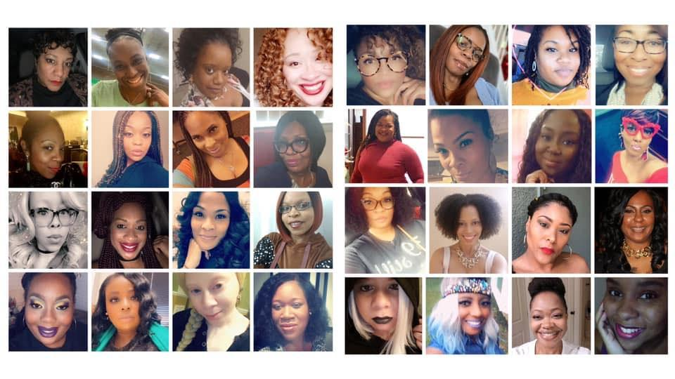
Welcome to TRES!!! We want to ensure that you have the best experience as a sales affiliate. If you have any questions that have not been answered by reading this Affiliate Manual, please email repservice@iamtres.com Welcome to the Team!!!!!!

